Slide 1
IMDB SONG Database INFO 5707 sec-002 Instructor- xiaoyu zhang
Team Members:
GROUP-20
Project leader Sadia Mahbub-10971223
Muppa Sai Srija-11523103
Vaishnavi Simhachalam-11525465

Slide 2
Agenda
Abstract
Introduction
Methodology
ER Diagram
Business Rules
Data Dictionary
User Requirements
Conclusion

Slide 3
Abstract
Songs play a major role in day to day life. Here we have collected the data about song like who is the composer, singer, director etc.
This database provides user with information about the song which he is looking for.
This database is made specially for students, but it is accessible by everyone all around the world.

Slide 4
SCOPE
The database being created contains a list of song names such as romantic songs, classical songs, movie songs, international songs, song titles and categories. Main song, song ID.
It includes song description, song audience, musician description, cost, composer, budget and more. All of the above information is used to develop the database in an organized way to make it easier for users to use and track research.
Through this database, viewers can also get information about the singers, directors and producers who contributed to the songs.

Slide 5
Introduction
The purpose of creating this database is to collect detailed information about songs and series and make it available to users. The main focus of IMDB`s songs and music database is to make live streams, music, songs and other content available to viewers along with summaries, themes, ratings and reviews. The database also suggests songs, music, and series based on the viewer's previous content selections. This database is currently available to users such as students and professors enrolled in the university.
Also, because this database is available to everyone at the university, many users hang out with it.

Slide 6
INTRO CONT..
The database you create contains a list of song titles that look like this: Romantic songs, classic songs, movie songs, international songs, song titles and categories, etc. Main song, song ID. This includes song descriptions, song audiences, musician descriptions, costs, composers, budgets, and more. All of the above information is used to develop the database in an organized way to make it easier for users to use and track the survey. Through this database, viewers can also get information about the singers, directors and producers who contributed to the song.

Slide 7
Methodology
We are using MySql to run the queries as it helps to add, access and process data stored in a computer database.
We have also performed an ER diagram to show the relationship between the entities

Slide 8
Business Rules
A song can have Multiple Singers,
A Singer can work in many songs.
A song can have only single rating,
A rating can be given to many songs.
A song can win zero or many price,
A price can be given to one song.
A song can be made in multiple languages,
A language can have many songs.
A song can have single set of cost,
A cost can work for many songs.

Slide 9
Business Rules cont..
A song can be produced by only one studio,
A studio can work on one or many songs.
A singer can sing many songs,
Multiple singers can sing multiple songs.
A song can have one or more titles,
A title can have more songs.
A song can be written one Lyricist,
A Lyricist can have one or more song

Slide 10
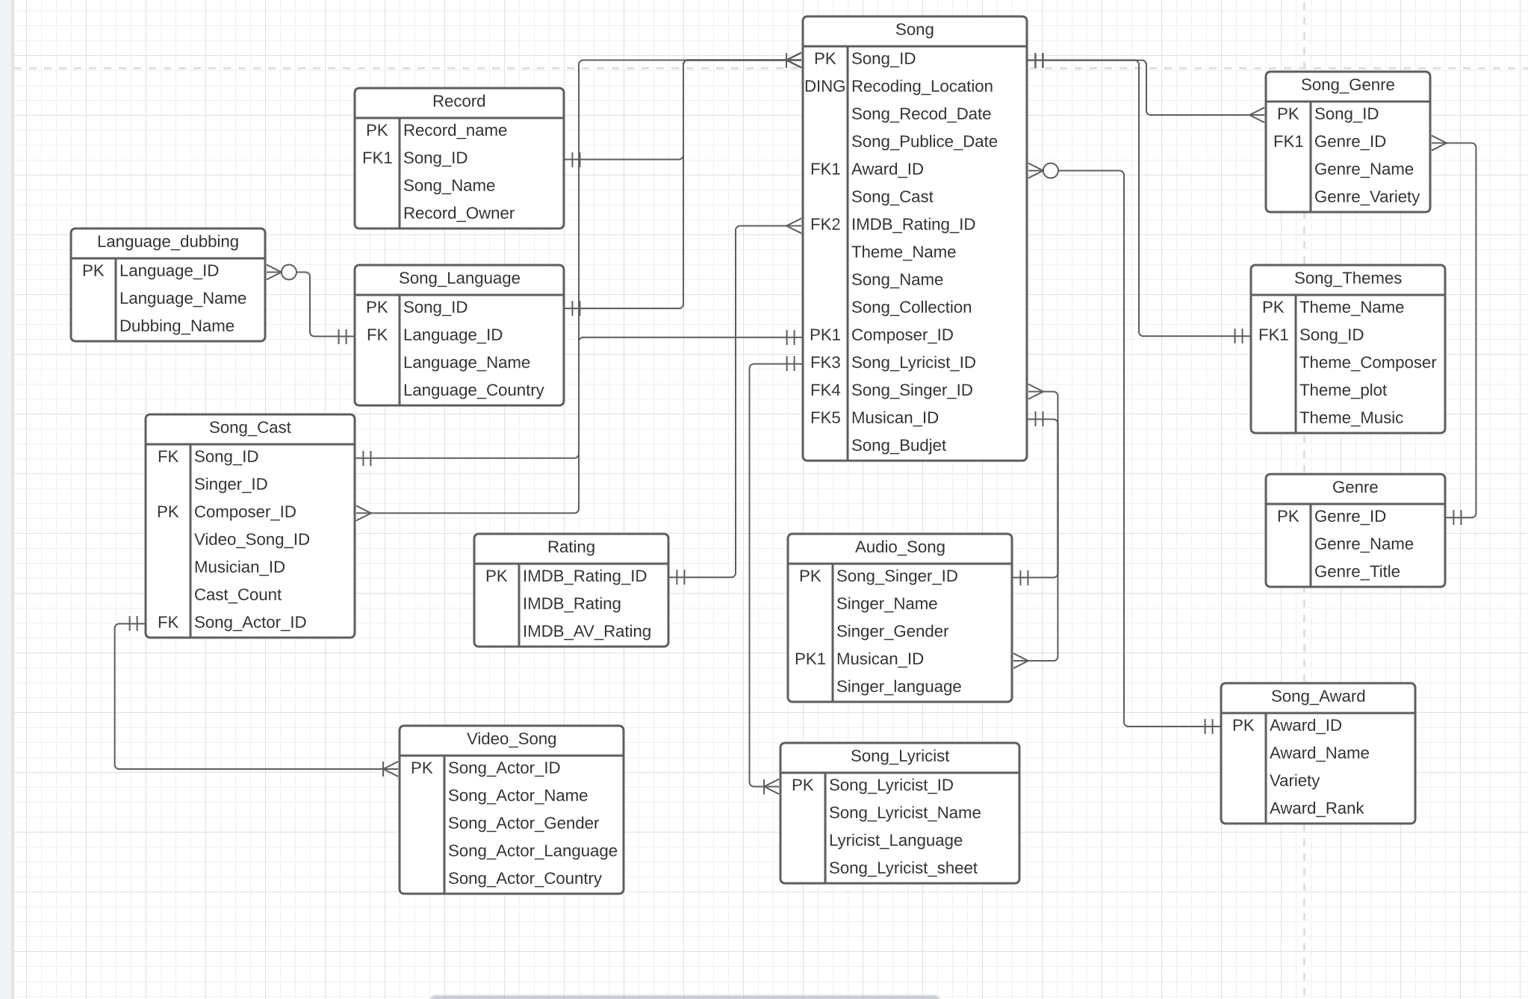
ER Diagram

Slide 11
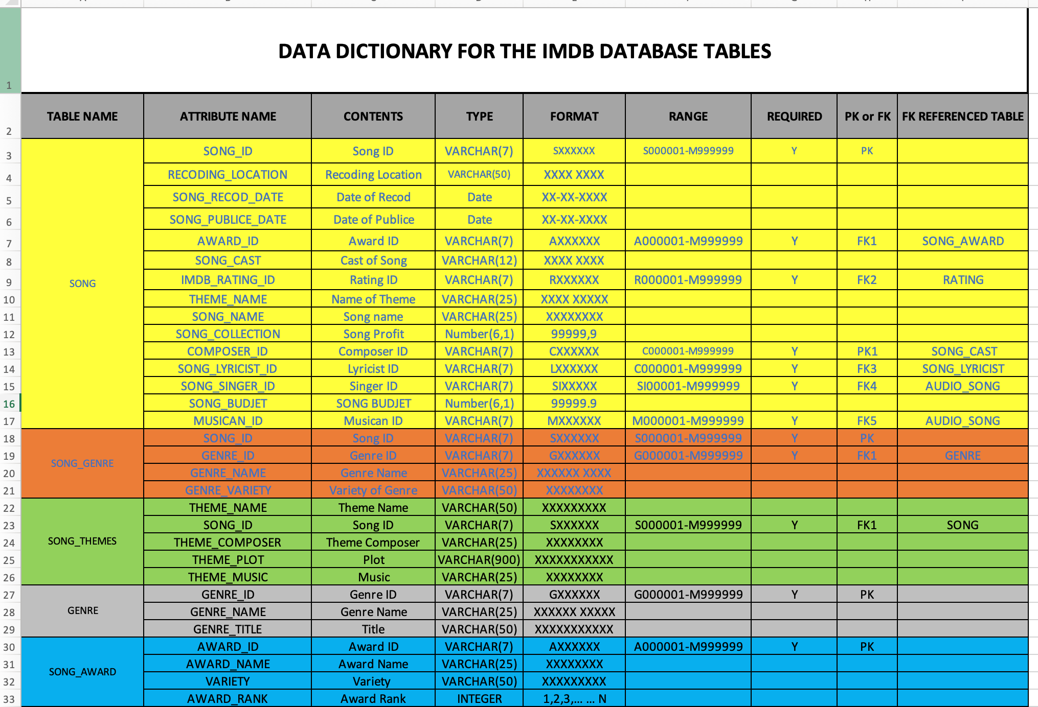
Data Dictionary

Slide 12
Queries
Table Creation and Data Entry:
Table1: songGenre
Table Creation:
create table songGenre(SNo Integer,songID integer, genreId integer, genreTypes varchar(20));
Displaying data:
select * from songGenre

Slide 13
Queries
Table2: rating
Table Creation:
create table rating(IMDBRatingID integer,IMDBRating varchar(20));
Displaying data:
select * from rating

Slide 14
Data Retrieval and Simple reports:
1. Select all song with their genre type.
Query: select m.title ,mg.genreTypes from movie m INNER JOIN songGenre mg on m.songID = mg.songID;
2. Select budget details of movie along with shooting location , release date.
Query: select title, budget, shootingLocation, releaseDate from song;

Slide 15
User Requirements
Singer: Singer is the most important field because it helps the user to have a complete list of songs. No song is complete without a singer, so the singer is the most important person in creating the song. It makes it possible for ordinary users to watch the songs of their favorite singers.
Language: Language is a very important part of this database. Most users want to hear a language that understands audio or video songs. This makes the song a more immersive experience. This database contains a list of all languages ​​in which the song resides.
Rating: Song writer: When a song is released to an audience, it is art, critiqued and appreciated by the audience. It helps the user to select a good song from the playlist.
Song Titles: Each singer releases an album with a name which could be anything, like what the song means or something that is in the song. (Exclaves story, written by Taylor Swift)

Slide 16
User Requirements
Song Titles: Each singer releases an album with a name which could be anything, like what the song means or something that is in the song. (Exclaves story, written by Taylor Swift)
Cost: Cost is of 2 types; A. The amount used to make the song
B. The amount collected for the album.
Studio: It is the place where the singer has signed a contract to share her songs for a price.
Ex: YG Entertainments
Producer: For making a song, an amount is spend and lot of production work is done for which a producer (“person”) he sponsors whatever is needed with a budget to get the outcome.

Slide 17
Conclusion
To conclude this report, IMBD is undeniably reliable in terms of providing reasonable and highly valuable ratings, reviews.
Knowledge and experiences from a people all around the world giving their opinions on all kinds of songs, movies, series etc making it easy for us to decide whether to watch it or not and what to expect from that particular album.
MySql is very flexible and cost efficient with high performance and strong data protection making it more of the reason to use .

Slide 18
Thank You

